Slide 1
Support Vector Machine
Session 17-18

Slide 2
Learning Outcome
LO 1: Explain the fundamental of machine learning concept
LO 2: Interpret the distribution of dataset using regression method
LO 3: Experiment classification and clustering algorithm from given dataset

Slide 3
Outline
Introduction
Maximal Margin Classifier
Support vector classifier
Support Vector Machine

Slide 4
Introduction

Slide 5
Introduction
Support vector machine (SVM) is:
A powerful, versatile, and the most popular Machine Learning model
Capable of performing linear or nonlinear classification, regression, and even outlier detection.
Well-suited for classification of complex small or medium-sized datasets.
SVM is a family of classification rules that contain both parametric (e.g., linear) and nonparametric (e.g., kernel based) methods.
It can be viewed as a generalization of linear decision boundaries for classification.
In particular, SVM produces nonlinear boundaries by constructing a linear boundary in a large, transformed version of the feature space.
We will mainly discuss three approaches: maximal margin classifier, the support vector classifier, and the support vector machine – people often loosely refer to these methods collectively as support vector machines.

Slide 6
Maximal Margin Classifier

Slide 7
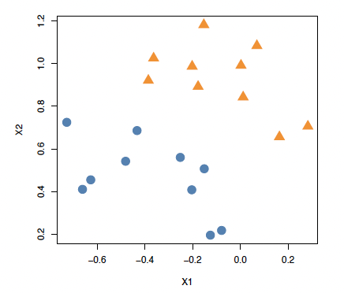
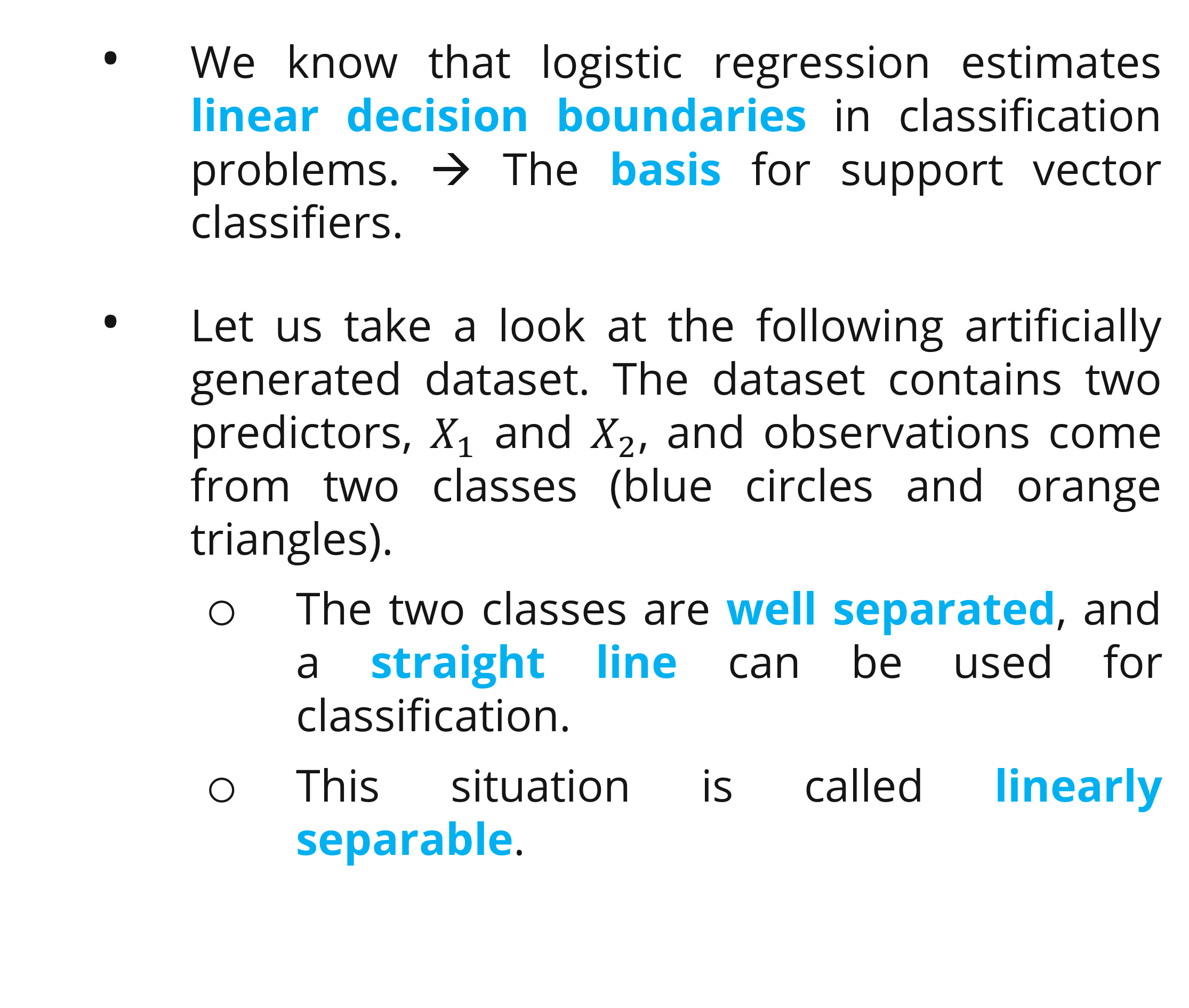
Maximal Margin Classifier
Separating Hyperplane
We know that logistic regression estimates linear decision boundaries in classification problems. → The basis for support vector classifiers.
Let us take a look at the following artificially generated dataset. The dataset contains two predictors, $X_{1}$ and $X_{2}$, and observations come from two classes (blue circles and orange triangles).
The two classes are well separated, and a straight line can be used for classification.
This situation is called linearly separable.

Slide 8
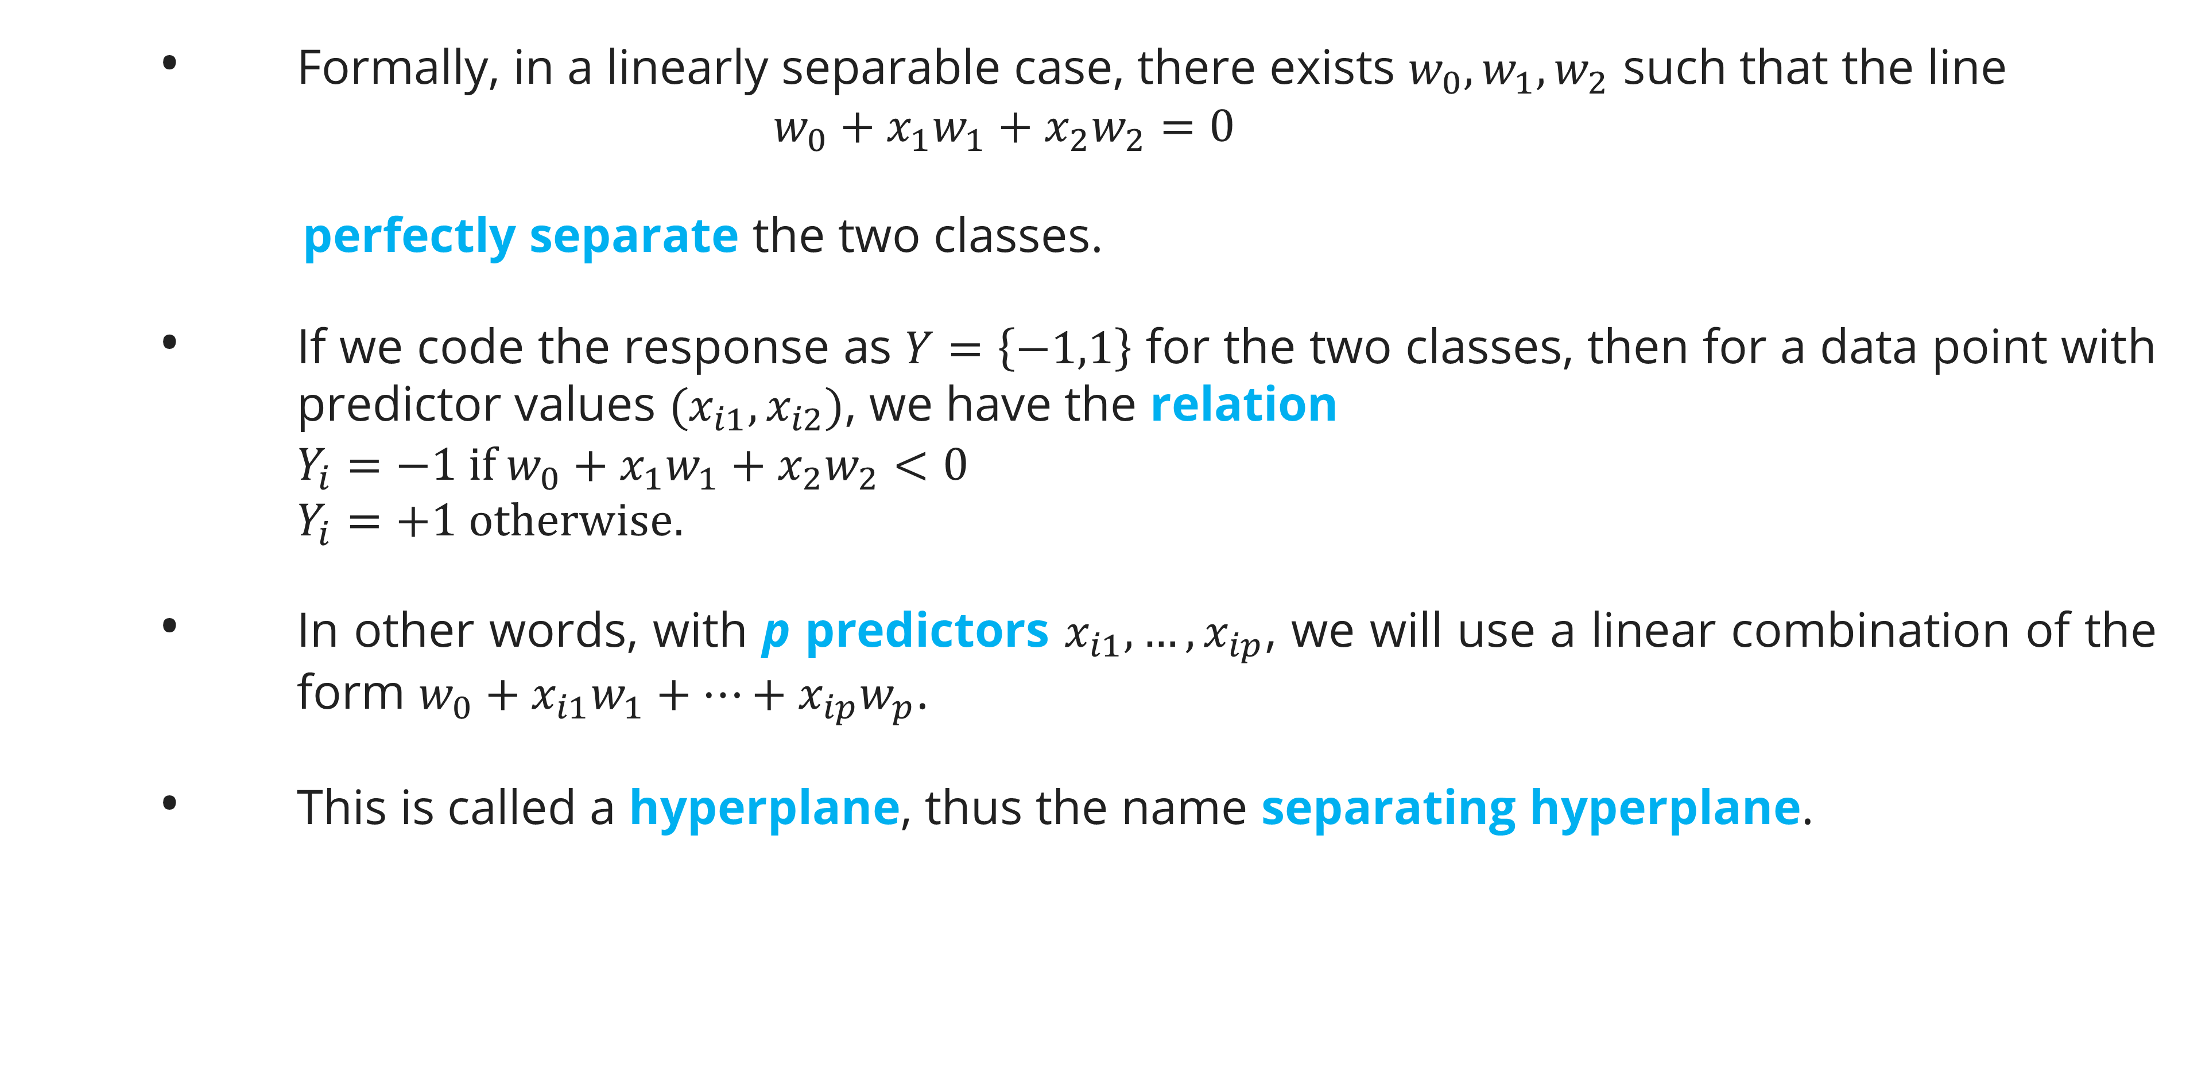
Maximal Margin Classifier
Separating Hyperplane
Formally, in a linearly separable case, there exists $w_{0},w_{1},w_{2}$ such that the line
$$w_{0}+x_{1}w_{1}+x_{2}w_{2}=0$$
perfectly separate the two classes.
If we code the response as $Y=\left\{−1,1\right\}$ for the two classes, then for a data point with predictor values $(x_{i1},x_{i2})$, we have the relation
$$Y_{i}=−1 if w_{0}+x_{1}w_{1}+x_{2}w_{2}<0$$
$$Y_{i}=+1 otherwise.$$
In other words, with p predictors $x_{i1},…,x_{ip}$, we will use a linear combination of the form $w_{0}+x_{i1}w_{1}+…+x_{ip}w_{p}$.
This is called a hyperplane, thus the name separating hyperplane.

Slide 9
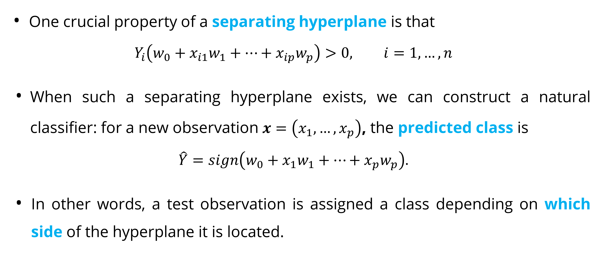
Maximal Margin Classifier
Separating Hyperplane
One crucial property of a separating hyperplane is that
$$Y_{i}\left(w_{0}+x_{i1}w_{1}+…+x_{ip}w_{p}\right)>0, i=1,…,n$$
When such a separating hyperplane exists, we can construct a natural classifier: for a new observation $x=\left(x_{1},…,x_{p}\right)$, the predicted class is
$$\hat{Y}=sign\left(w_{0}+x_{1}w_{1}+…+x_{p}w_{p}\right).$$
In other words, a test observation is assigned a class depending on which side of the hyperplane it is located.

Slide 10
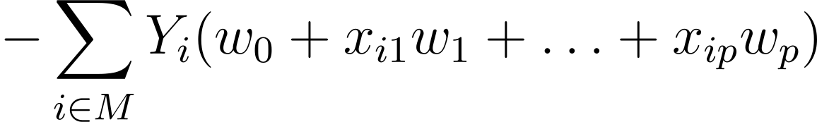
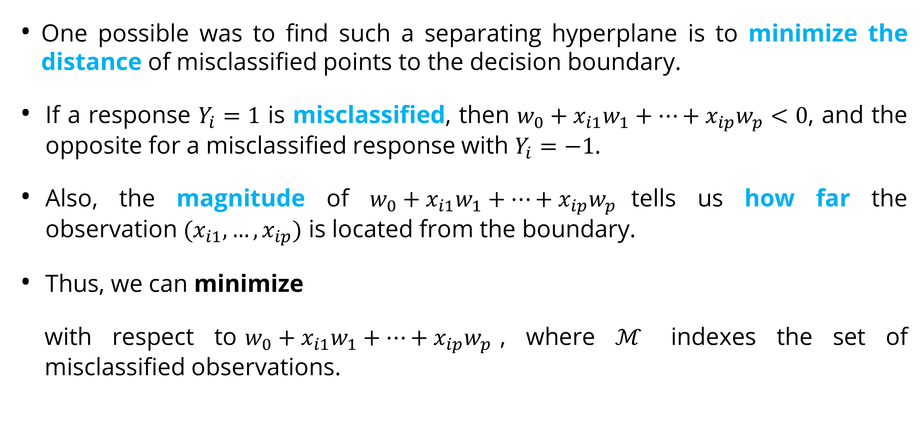
Maximal Margin Classifier
Maximal Margin
One possible was to find such a separating hyperplane is to minimize the distance of misclassified points to the decision boundary.
If a response $Y_{i}=1$ is misclassified, then $w_{0}+x_{i1}w_{1}+…+x_{ip}w_{p}<0$, and the opposite for a misclassified response with $Y_{i}=−1$.
Also, the magnitude of $w_{0}+x_{i1}w_{1}+…+x_{ip}w_{p}$tells us how far the observation $(x_{i1},…,x_{ip})$ is located from the boundary.
Thus, we can minimize
with respect to$w_{0}+x_{i1}w_{1}+…+x_{ip}w_{p}$, where $ℳ$ indexes the set of misclassified observations.

Slide 11
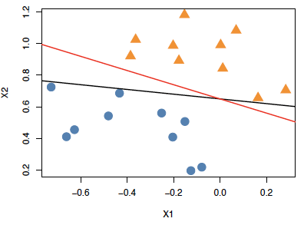
Maximal Margin Classifier
Maximal Margin
However, when the problem is linearly separable, there are infinitely many such separating hyperplanes.
In this perfectly separable case, given any separating hyperplane, we can define the margin as the minimal distance from the observations to the hyperplane.
The optimal classification rule is the line that maximizes the margin around the separating line.
Such a classifier is called the maximal margin classifier.
Example of multiple separating hyperplanes for the same data.

Slide 12
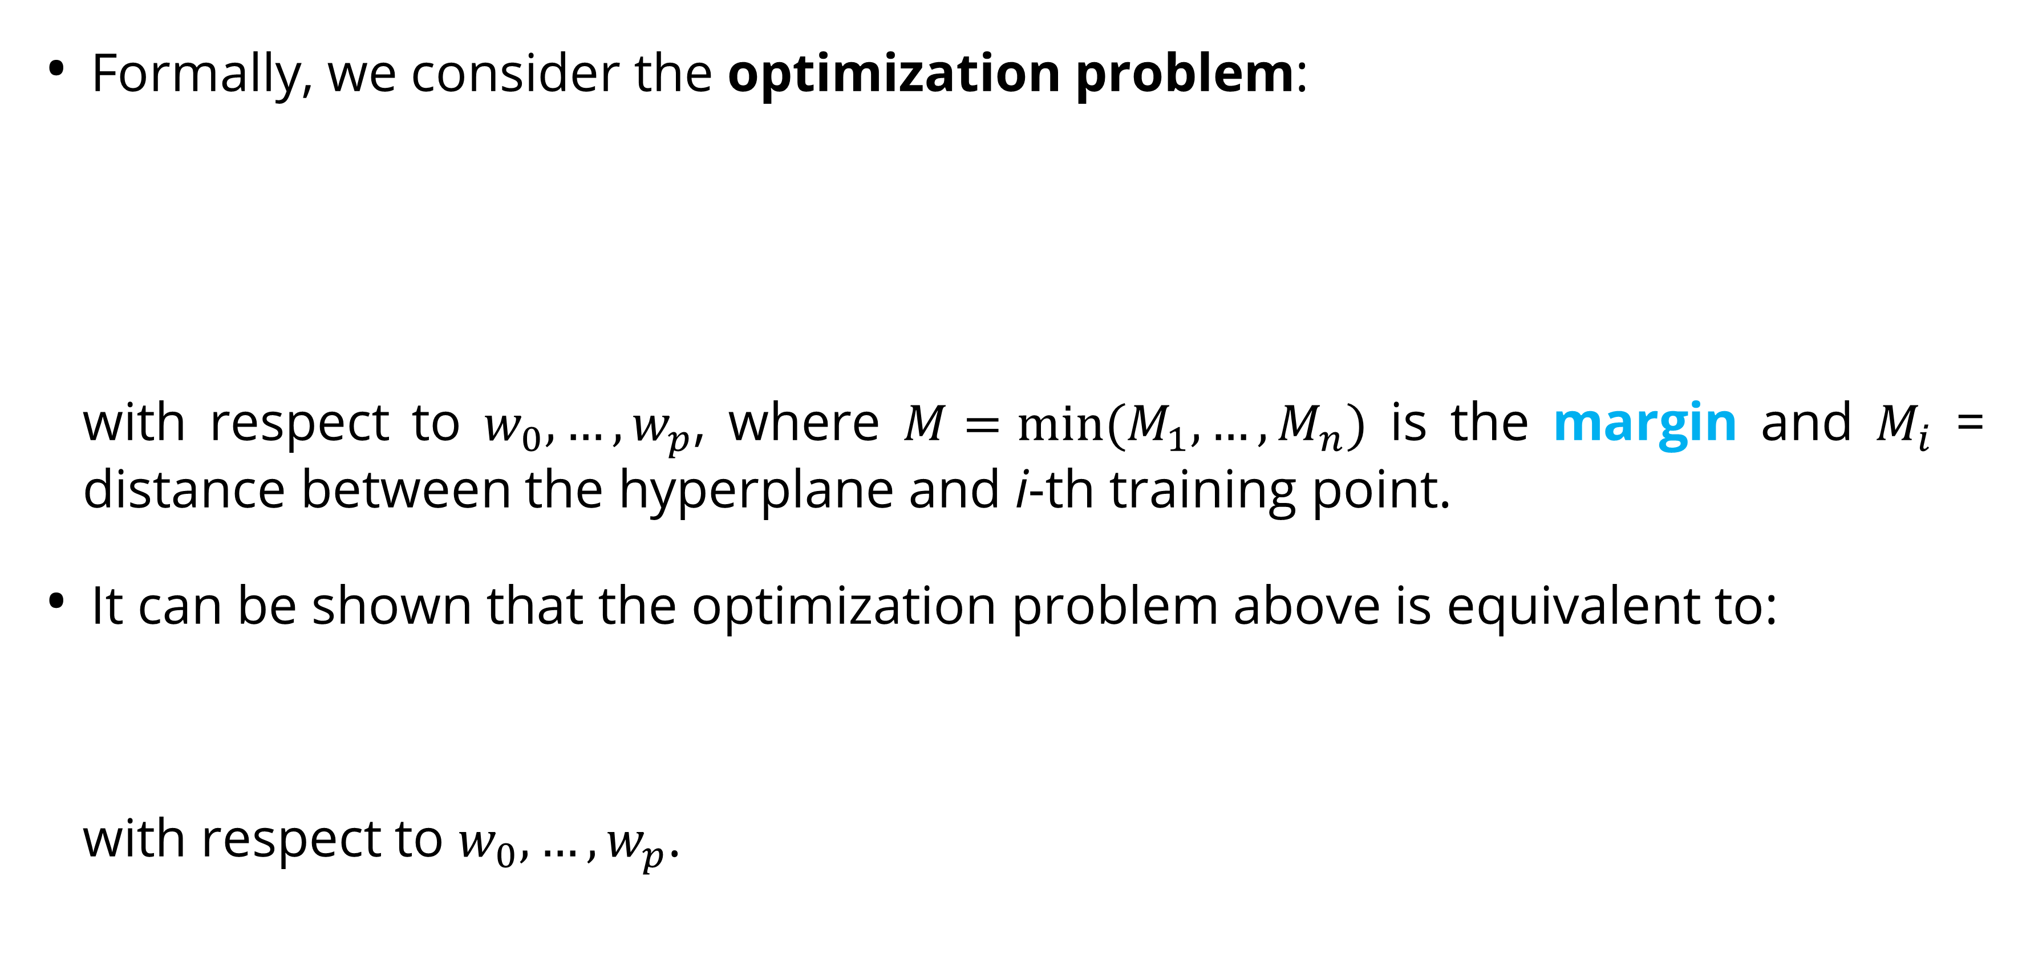
Maximal Margin Classifier
Maximal Margin
Formally, we consider the optimization problem:
with respect to $w_{0},…,w_{p}$, where $M=min⁡(M_{1},…,M_{n})$ is the margin and $M_{i}$ = distance between the hyperplane and i-th training point.
It can be shown that the optimization problem above is equivalent to:
with respect to $w_{0},…,w_{p}$.

Slide 13
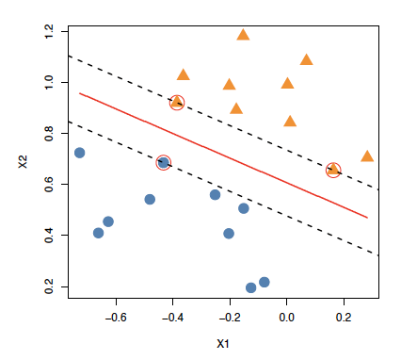
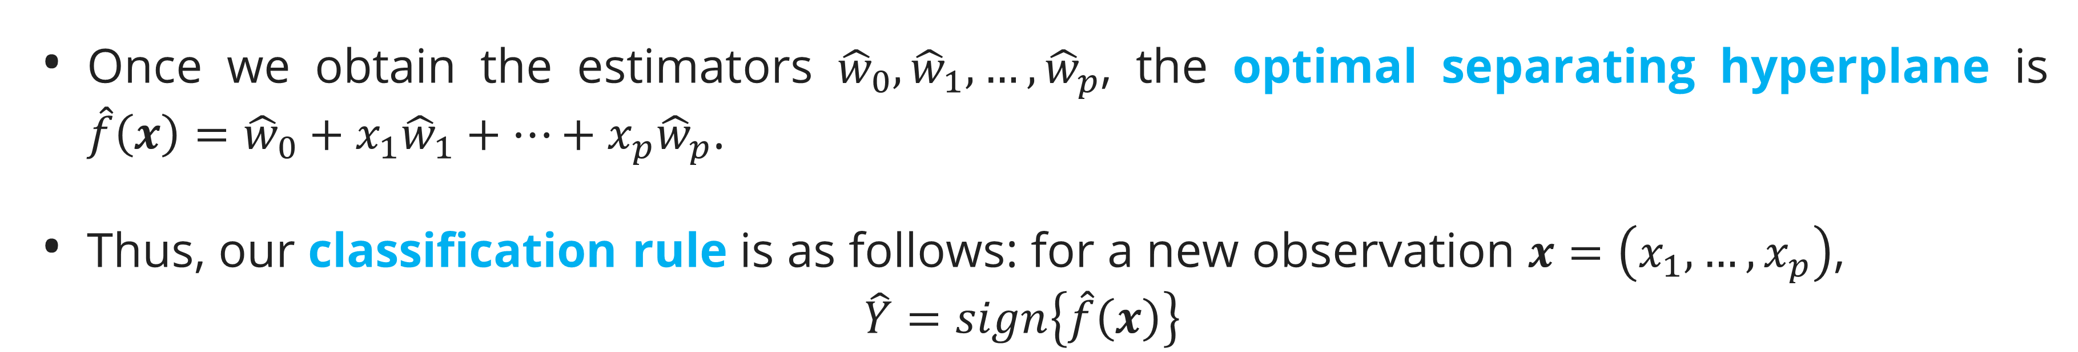
Maximal Margin Classifier
Maximal Margin
Once we obtain the estimators ${\hat{w}}_{0},{\hat{w}}_{1},…,{\hat{w}}_{p}$, the optimal separating hyperplane is $\hat{f}\left(x\right)={\hat{w}}_{0}+x_{1}{\hat{w}}_{1}+…+x_{p}{\hat{w}}_{p}$.
Thus, our classification rule is as follows: for a new observation $x=\left(x_{1},…,x_{p}\right)$,
$$\hat{Y}=sign\left\{\hat{f}\left(x\right)\right\}$$
In the figure, the optimal separating line is shown as the solid red line, the closest points to the line are circled, and the separation between the classes is shown using the dashed black lines.
Notice that the are a few points (circled) that are closest, and equidistant, to the red separating line.

Slide 14
Maximal Margin Classifier
Maximal Margin
These three points lie along the dashed lines indicating the width of the margin, that is, these points satisfy the condition
These points are called the support vectors for this problem. It can be shown that only the support vectors are enough to define the optimal classification rule fully.
This property of the maximal margin classifier is important in development of support vector classifier and support vector machine.

Slide 15
Support Vector Classifier

Slide 16
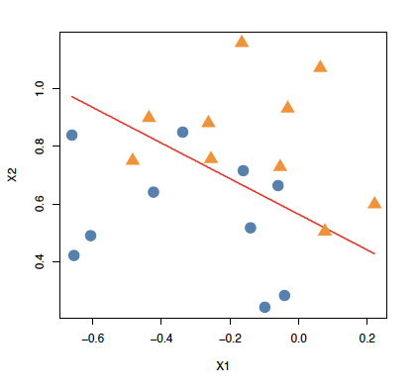
Support Vector Classifier
Support Vector/ Soft-Margin
When the two classes are not linearly separable (see figure), we will not be able to find a line that entirely separates the groups, i.e. the maximal margin classifier can not be computed.
Thus, the two classes cannot be classified exactly.
We can, however, generalize the ideas to develop a classification rule that almost separates the classes.
To do so, we allow a few points to fall on the wrong side of the margin or separating hyperplane.
Such a classifier is called a support vector classifier or a soft-margin classifier.

Slide 17
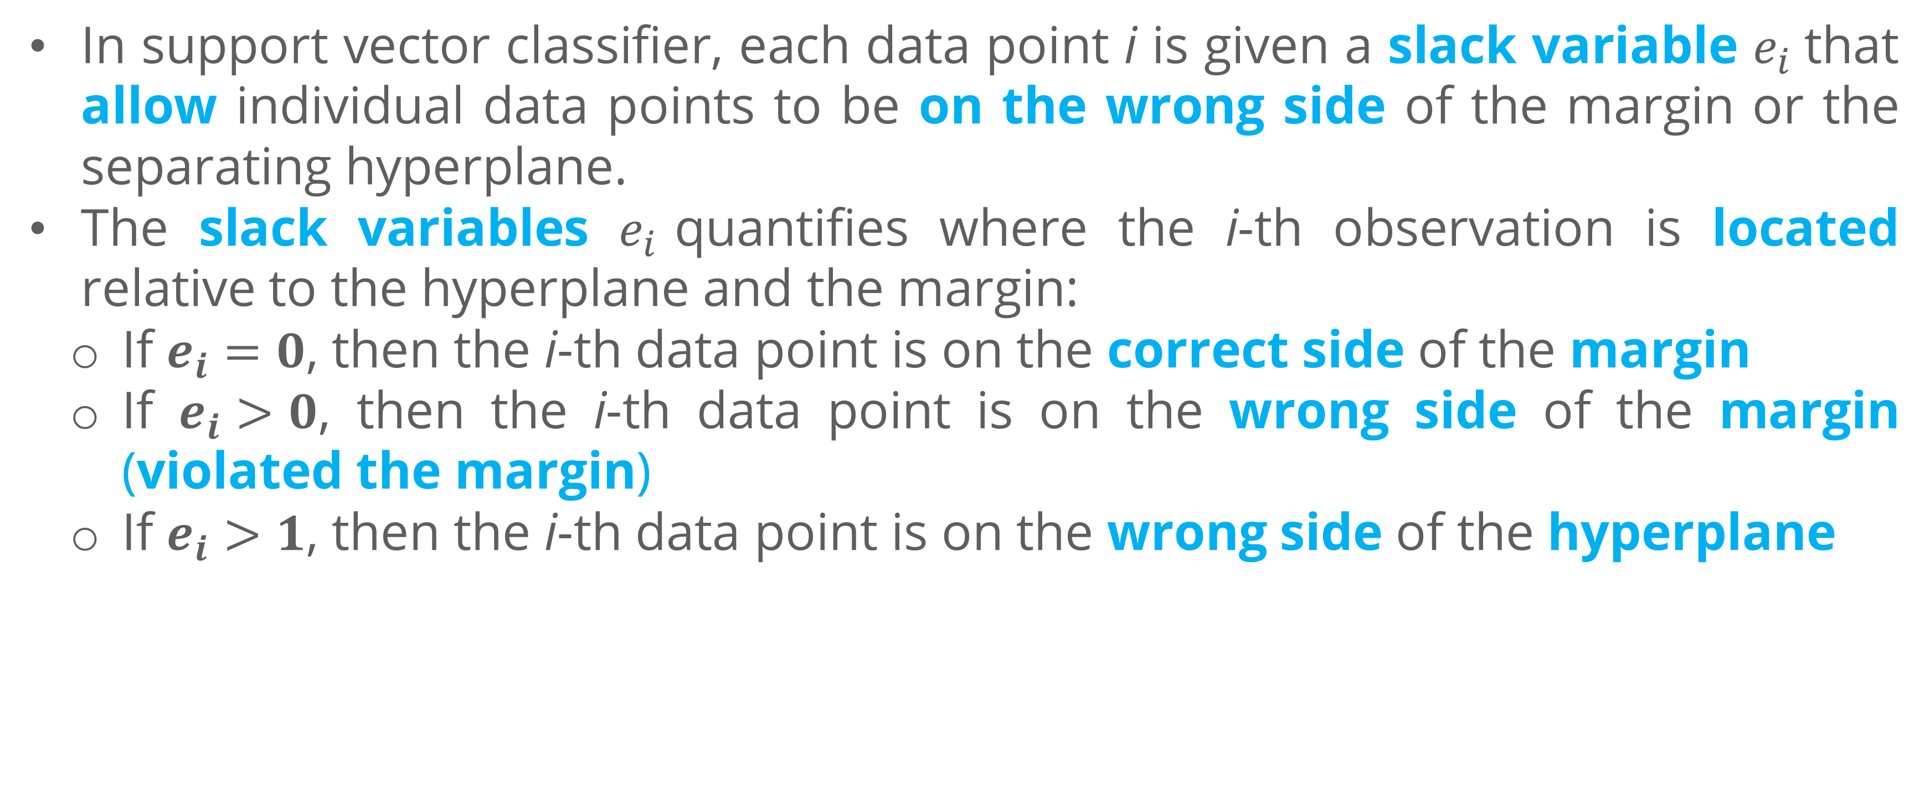
Support Vector Classifier
Support Vector/ Soft-Margin
In support vector classifier, each data point i is given a slack variable $e_{i}$that allow individual data points to be on the wrong side of the margin or the separating hyperplane.
The slack variables $e_{i}$quantifies where the i-th observation is located relative to the hyperplane and the margin:
If $e_{i}=0$, then the i-th data point is on the correct side of the margin
If $e_{i}>0$, then the i-th data point is on the wrong side of the margin (violated the margin)
If $e_{i}>1$, then the i-th data point is on the wrong side of the hyperplane

Slide 18
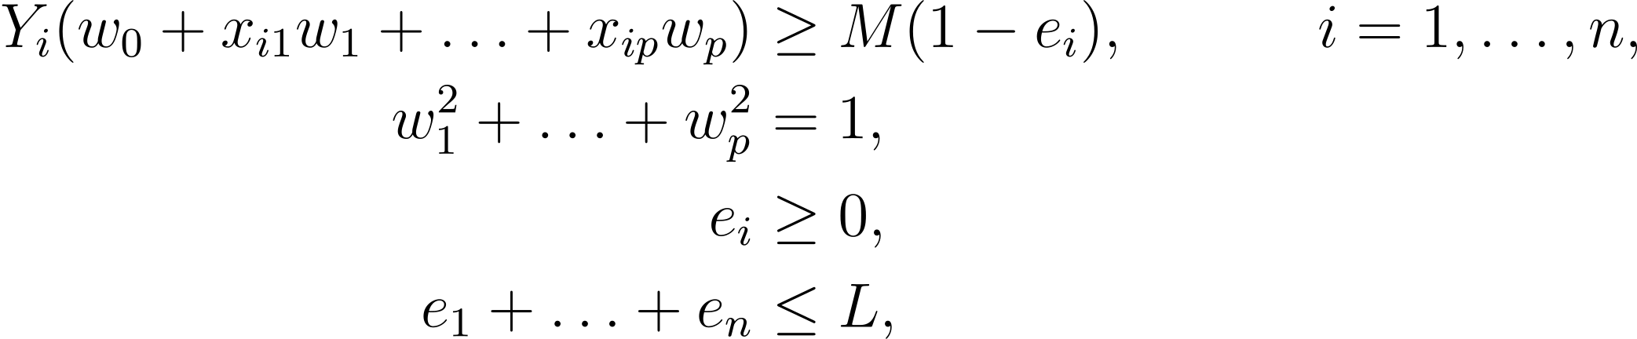
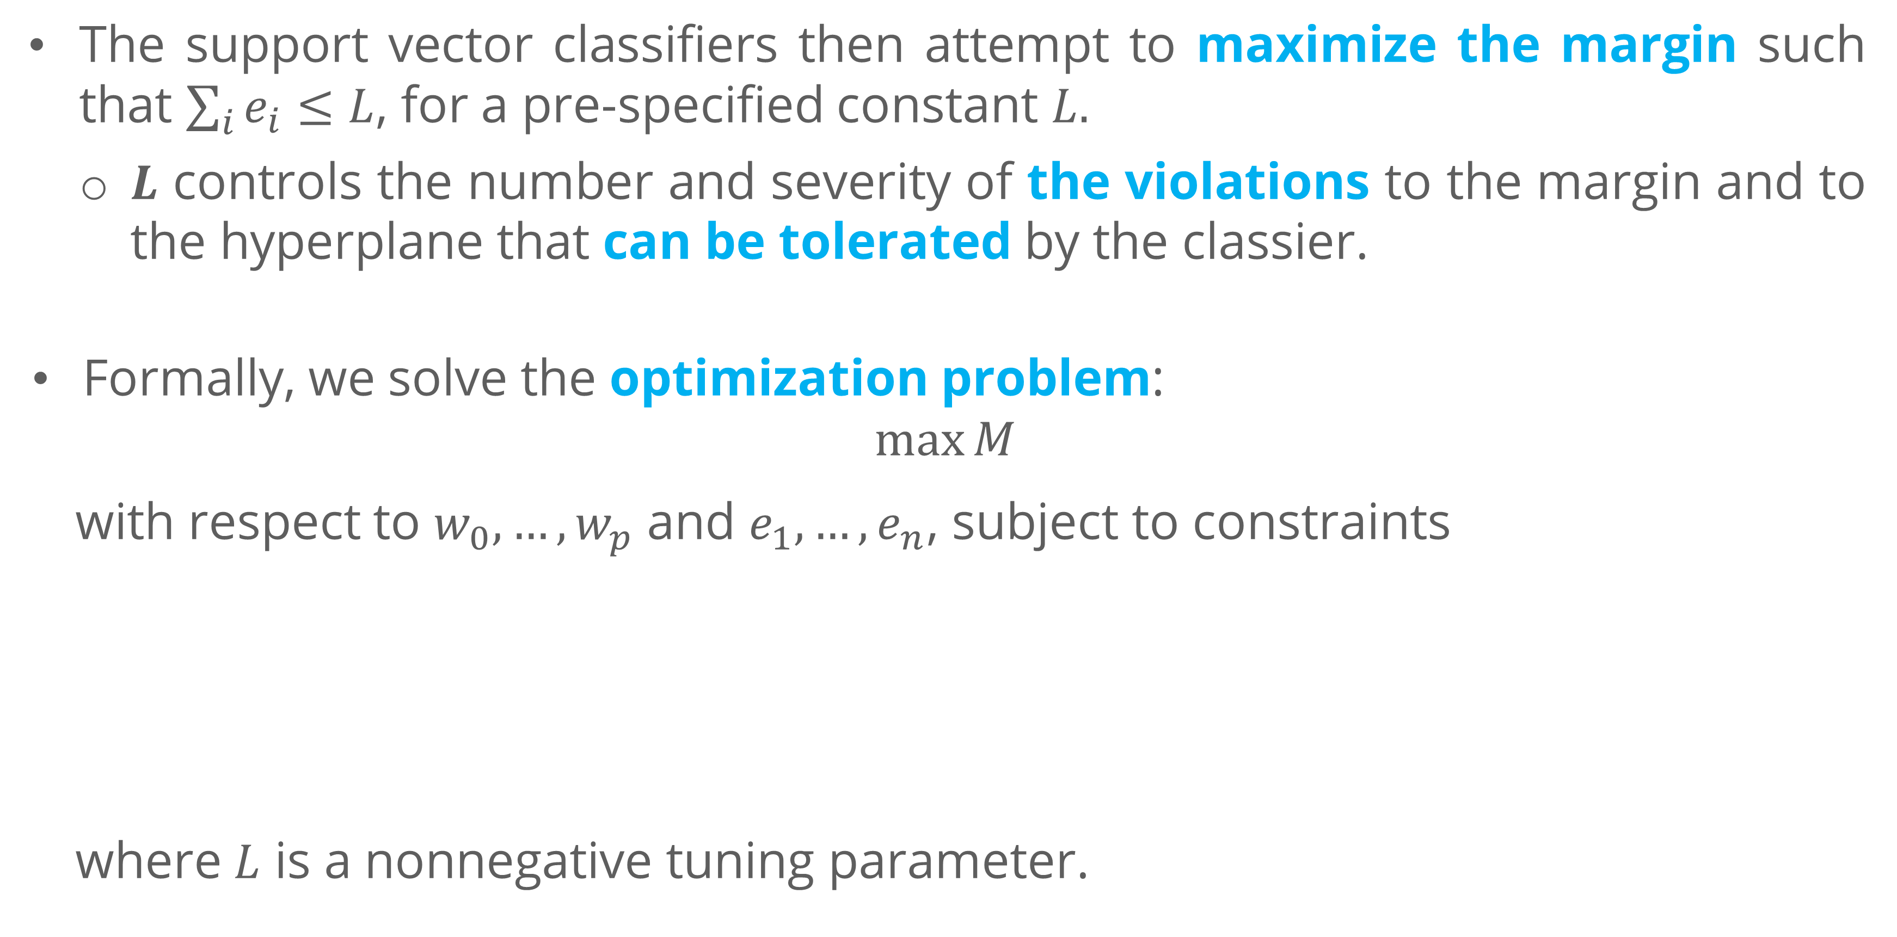
Support Vector Classifier
Support Vector/ Soft-Margin
The support vector classifiers then attempt to maximize the margin such that $\sum_{i}{e_{i}}≤L$, for a pre-specified constant $L.$
$L$ controls the number and severity of the violations to the margin and to the hyperplane that can be tolerated by the classier.
Formally, we solve the optimization problem:
$$\max{M}$$
with respect to $w_{0},…,w_{p}$ and $e_{1},…,e_{n}$, subject to constraints
where $L$ is a nonnegative tuning parameter.

Slide 19
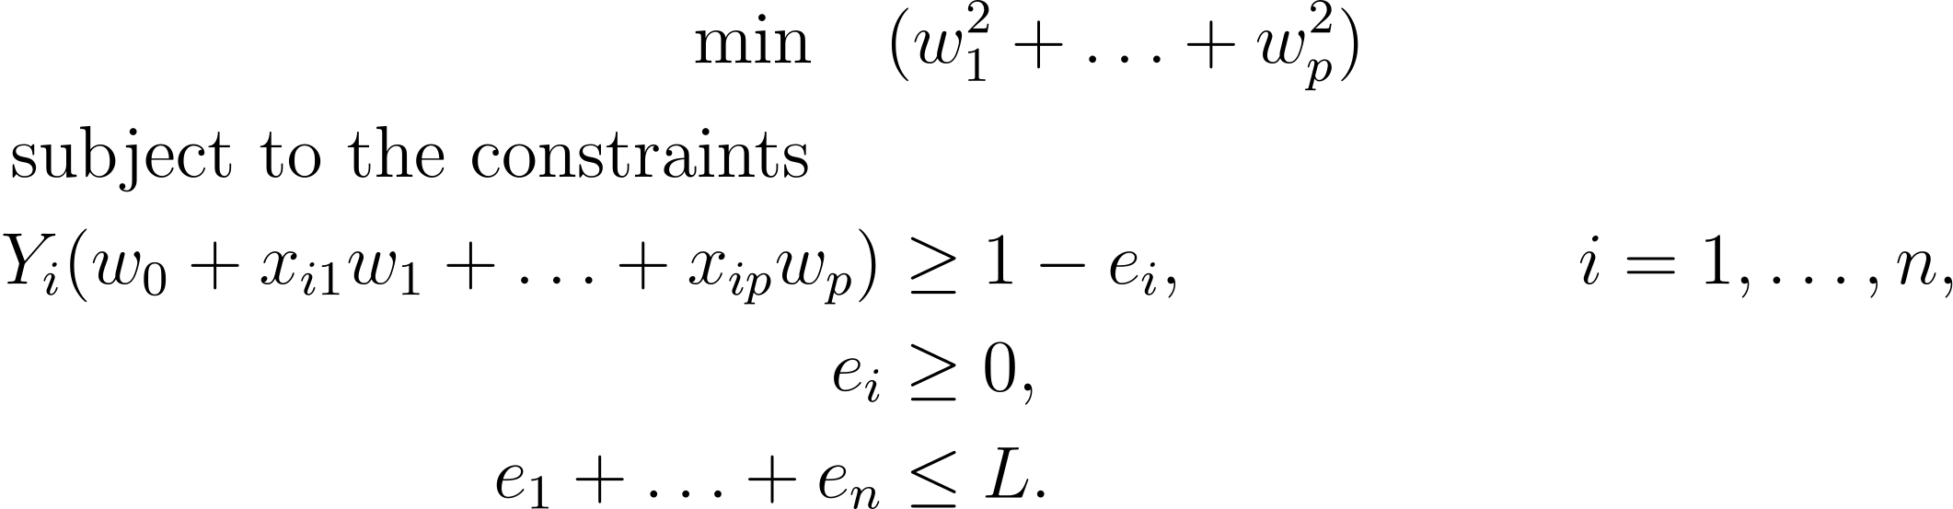
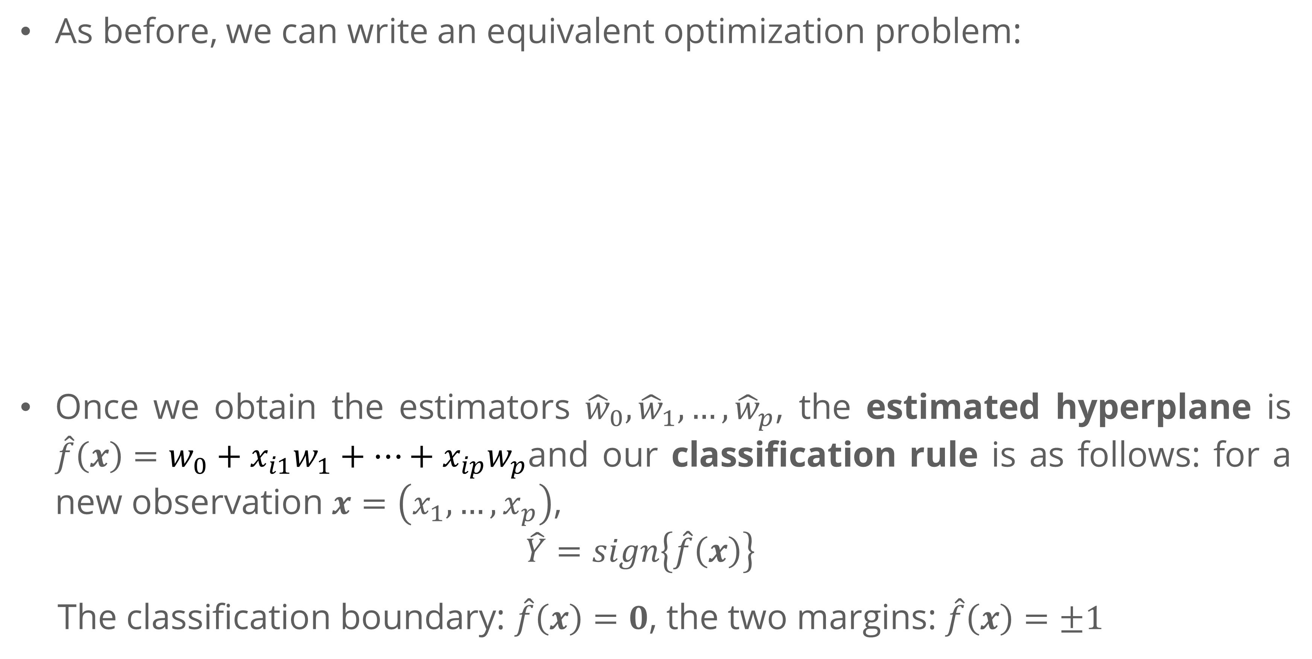
Support Vector Classifier
Support Vector/ Soft-Margin
As before, we can write an equivalent optimization problem:
Once we obtain the estimators ${\hat{w}}_{0},{\hat{w}}_{1},…,{\hat{w}}_{p}$, the estimated hyperplane is $\hat{f}\left(x\right)=w_{0}+x_{i1}w_{1}+…+x_{ip}w_{p}$and our classification rule is as follows: for a new observation $x=\left(x_{1},…,x_{p}\right)$,
$$\hat{Y}=sign\left\{\hat{f}\left(x\right)\right\}$$
The classification boundary: $\hat{f}\left(x\right)=0$, the two margins: $\hat{f}\left(x\right)=±1$

Slide 20
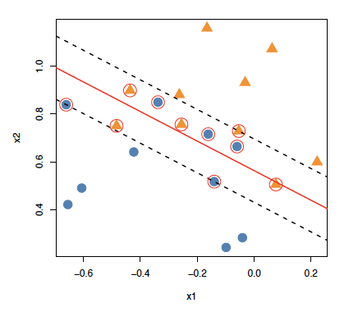
Support Vector Classifier
Support Vector/ Soft-Margin
As with the maximal margin classifier, the classifier is affected only by the observations that lie on the margin or violates the margin.
Data points that lies strictly on the correct side of the margin does not affect the support vector classifier at all.
In this case, data points that fall directly on the margin, or on the wrong side of the margin for their class, are known as support vectors.
The circled points in the figure are the support vectors for the the classifier shown using the red line.

Slide 21
Support Vector Machine

Slide 22
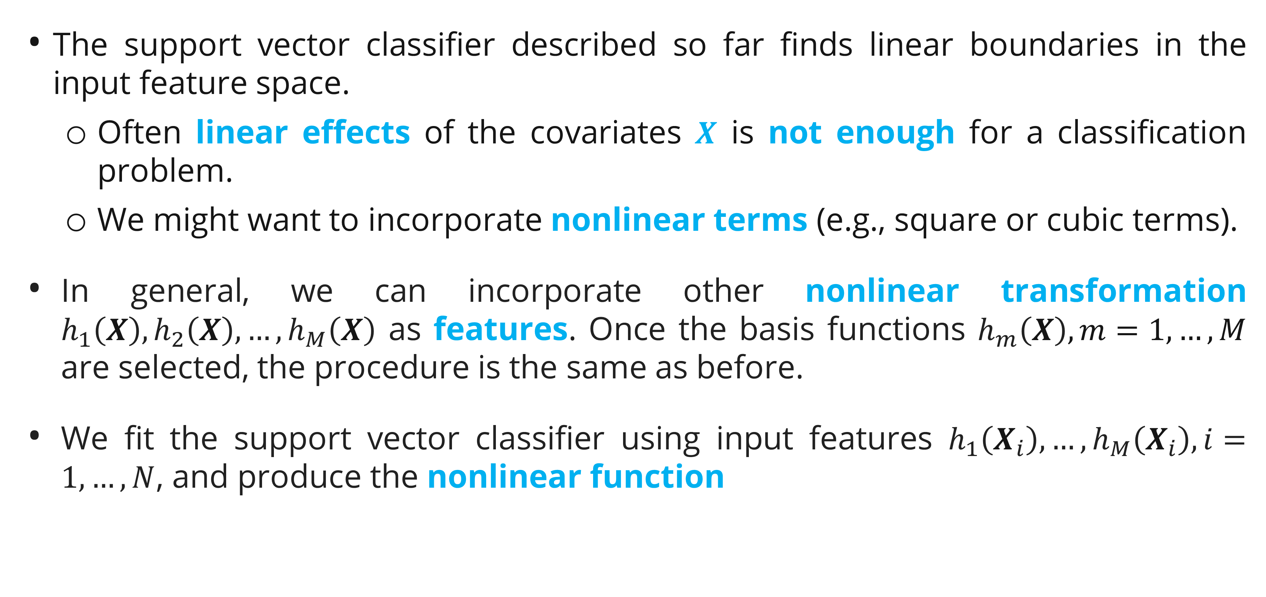
Support Vector Machine
Incorporating Nonlinear Terms
The support vector classifier described so far finds linear boundaries in the input feature space.
Often linear effects of the covariates $X$ is not enough for a classification problem.
We might want to incorporate nonlinear terms (e.g., square or cubic terms).
In general, we can incorporate other nonlinear transformation $h_{1}\left(X\right),h_{2}\left(X\right),…,h_{M}\left(X\right)$ as features. Once the basis functions $h_{m}\left(X\right), m=1,…,M$ are selected, the procedure is the same as before.
We fit the support vector classifier using input features $h_{1}\left(X_{i}\right),…,h_{M}\left(X_{i}\right),i=1,…,N$, and produce the nonlinear function

Slide 23
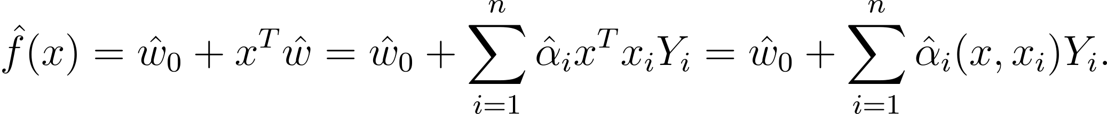
Support Vector Machine
Kernel Trick
Support vector machines (SVM) generalize support vector classifiers by including nonlinear features in a specific way that allows us to add many such features as well as a high number of variables.
Without going into mathematics, SVM does so using the so called kernel trick, i.e. by specifying a kernel function that controls which nonlinear features to include in the classifier.
The solution to the support vector classifier problem can be represented as

Slide 24
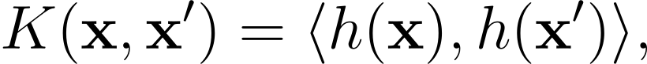
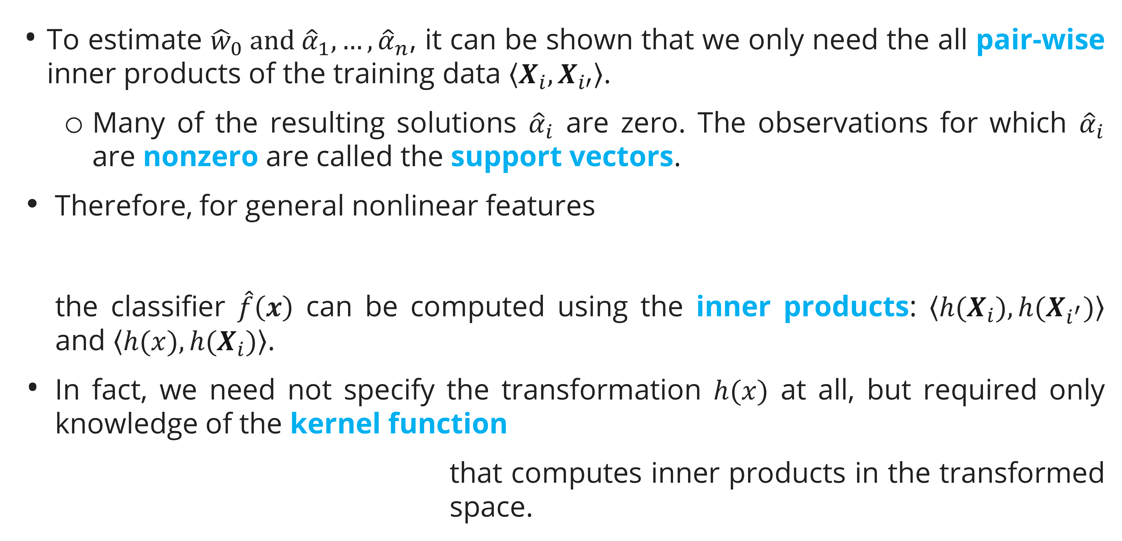
Support Vector Machine
Kernel Trick
To estimate ${\hat{w}}_{0} and {\hat{α}}_{1},…,{\hat{α}}_{n}$, it can be shown that we only need the all pair-wise inner products of the training data $\left\langle X_{i},X_{i′}\right\rangle$.
Many of the resulting solutions ${\hat{α}}_{i}$ are zero. The observations for which ${\hat{α}}_{i}$ are nonzero are called the support vectors.
Therefore, for general nonlinear features
the classifier $\hat{f}\left(x\right)$ can be computed using the inner products: $\left\langle h(X_{i}),{h(X}_{i^{′}})\right\rangle$ and $\left\langle h(x),{h(X}_{i})\right\rangle$.
In fact, we need not specify the transformation $h(x)$ at all, but required only knowledge of the kernel function
that computes inner products in the transformed space.

Slide 25
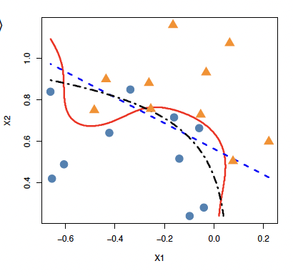
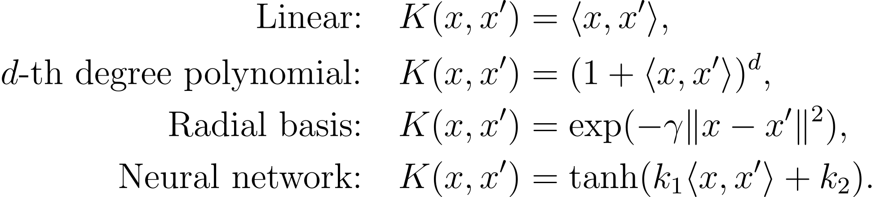
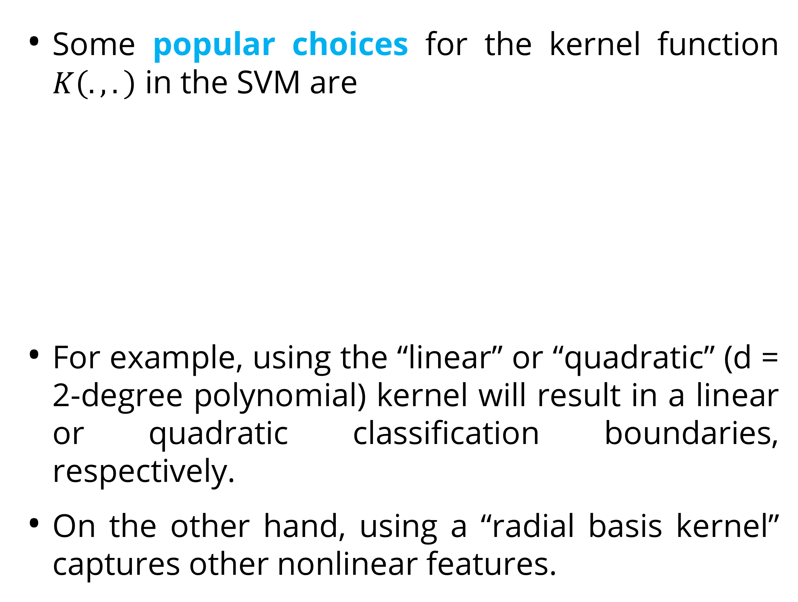
Support Vector Machine
Kernel Trick
Some popular choices for the kernel function $K\left(.,.\right)$ in the SVM are
For example, using the “linear” or “quadratic” (d = 2-degree polynomial) kernel will result in a linear or quadratic classification boundaries, respectively.
On the other hand, using a “radial basis kernel” captures other nonlinear features.
Simulated two-class data with linear (blue dashed), quadratic (black dash-dotted) and radial-basis based (red solid) classification rules.

Slide 26
Exercise

Slide 27
Exercise
You are a data scientist tasked with analyzing the Titanic dataset. The ultimate goal of your analysis is to build a model that can predict which passengers survived the Titanic disaster (https://www.kaggle.com/competitions/titanic). Your objective is to build a logistic regression model to predict the binary outcome of survival for the Titanic passengers.
Split the dataset into a training set and a testing set to evaluate your model's performance (70:30).
Develop a Support Vector Machine model using your selected features.
Evaluate the performance of your Support Vector Machine model using metrics such as accuracy, precision, recall, and the ROC-AUC score.
Provide a detailed analysis of the confusion matrix to understand the true positives, false positives, true negatives, and false negatives.

Slide 28
References

Slide 29
References
Géron, A. (2019). Hands-on machine learning with Scikit-Learn, Keras, and TensorFlow: Concepts, tools, and techniques to build intelligent systems (Second edition). O’Reilly.
James, G., Witten, D., Hastie, T., Tibshirani, R., & Taylor, J. E. (2023). An introduction to statistical learning: With applications in Python. Springer.

